Slide 1
Artificial Intelligence and Machine Learning
Neural Networks

Slide 2
Lecture Outline
Logistic Regression Review
Neural Networks
Forward pass
Backward pass

Slide 3
Review: Logistic Regression

Slide 4
Linear Classifier
The linear classifier we will study is basically a regression model with two key modifications:
Pass the regression outputs through a special function to convert them into probabilities.
Replace the Mean Squared Error loss with a new loss function designed for probabilities.
Applying these two to the Linear Regression should give Linear Classifier (called Logistic Regression).
Notes:
Speical function: map(regression) -> probabilities
Replacing the MSE

Slide 5
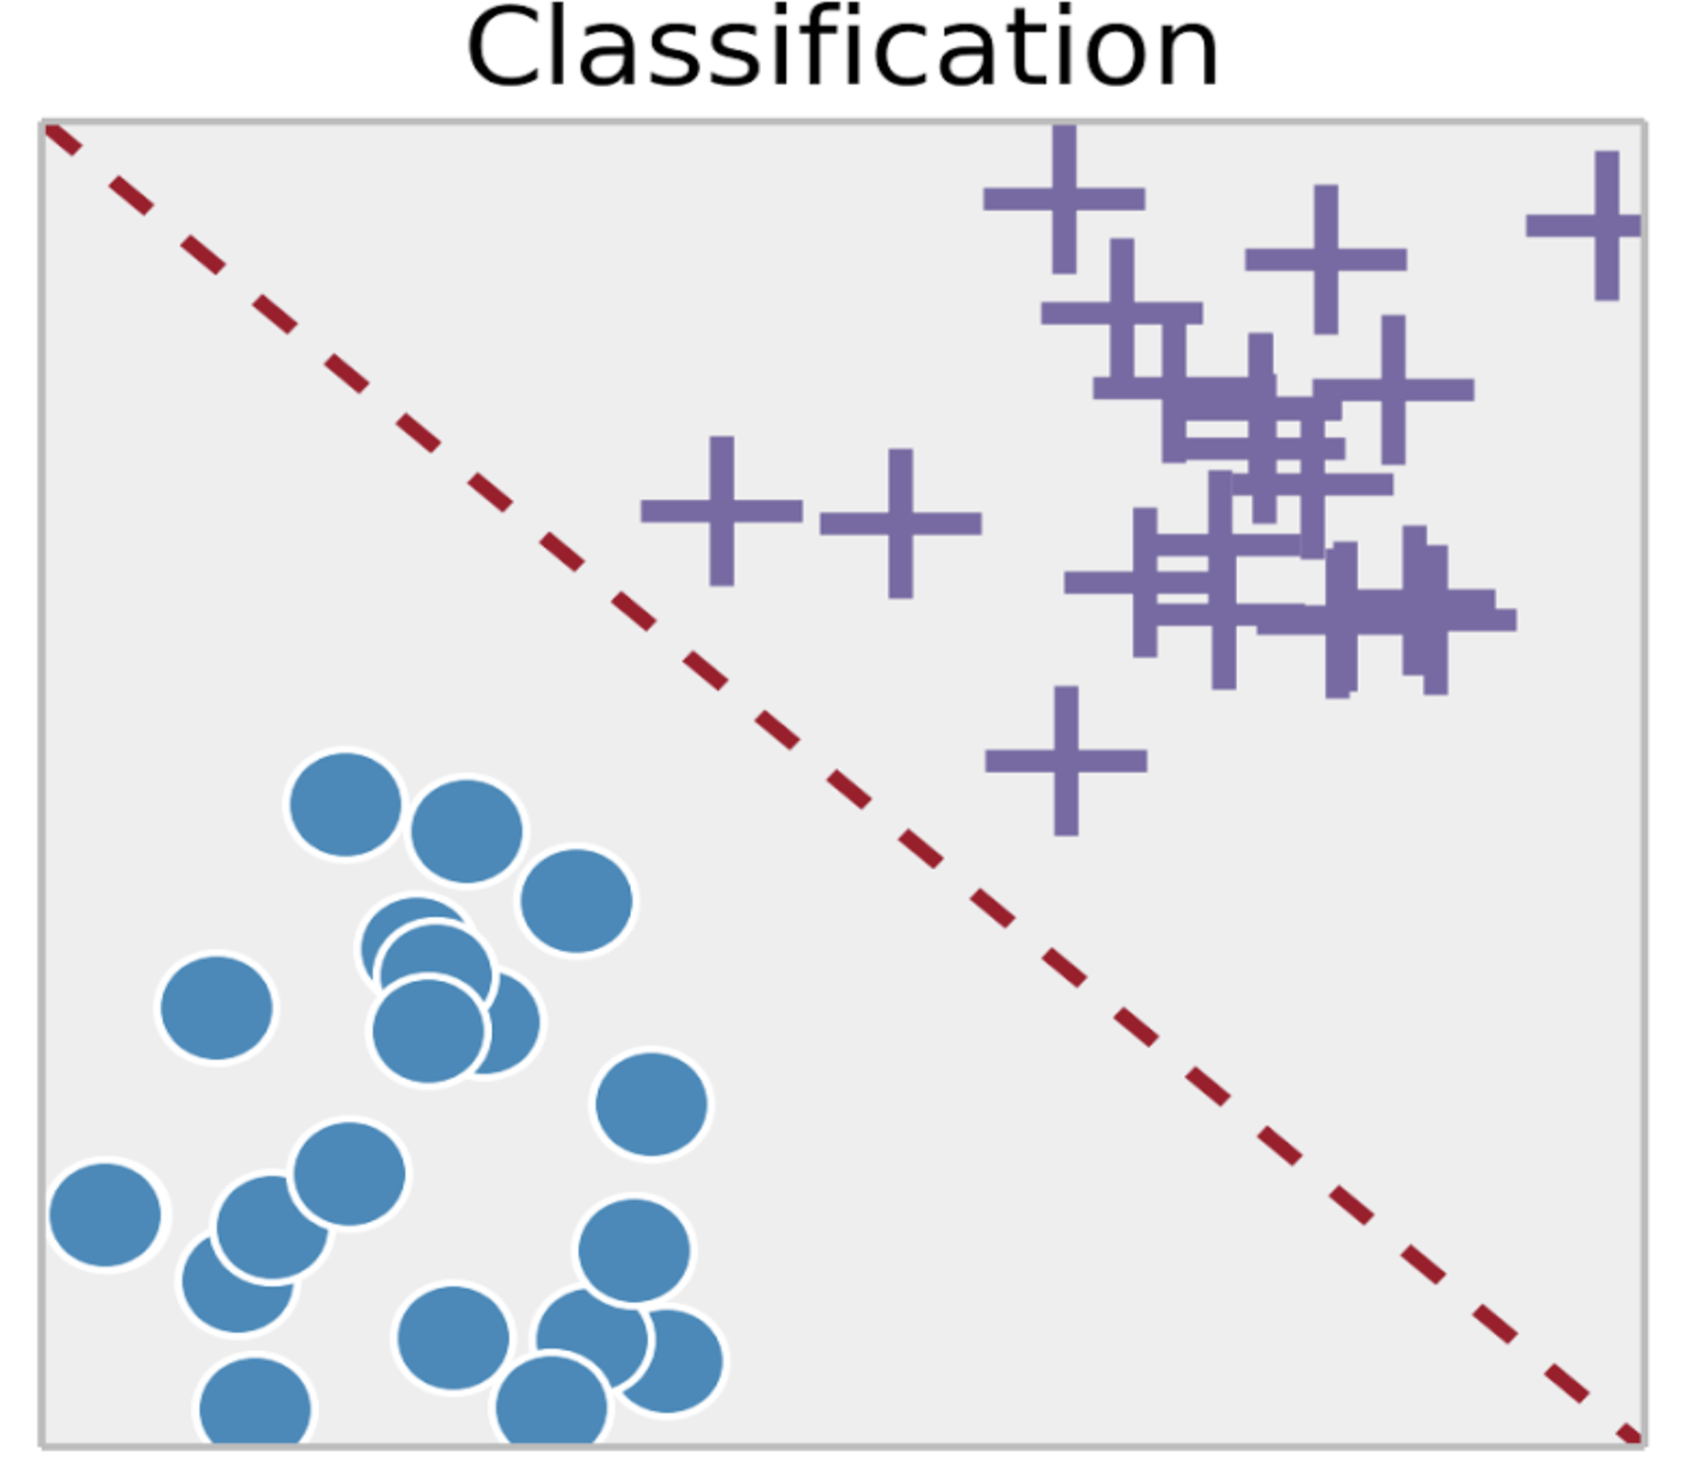
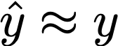
Linear Model in Disguise
Recall that the output/label y is binary
How to map the predictions to binary?

Slide 6
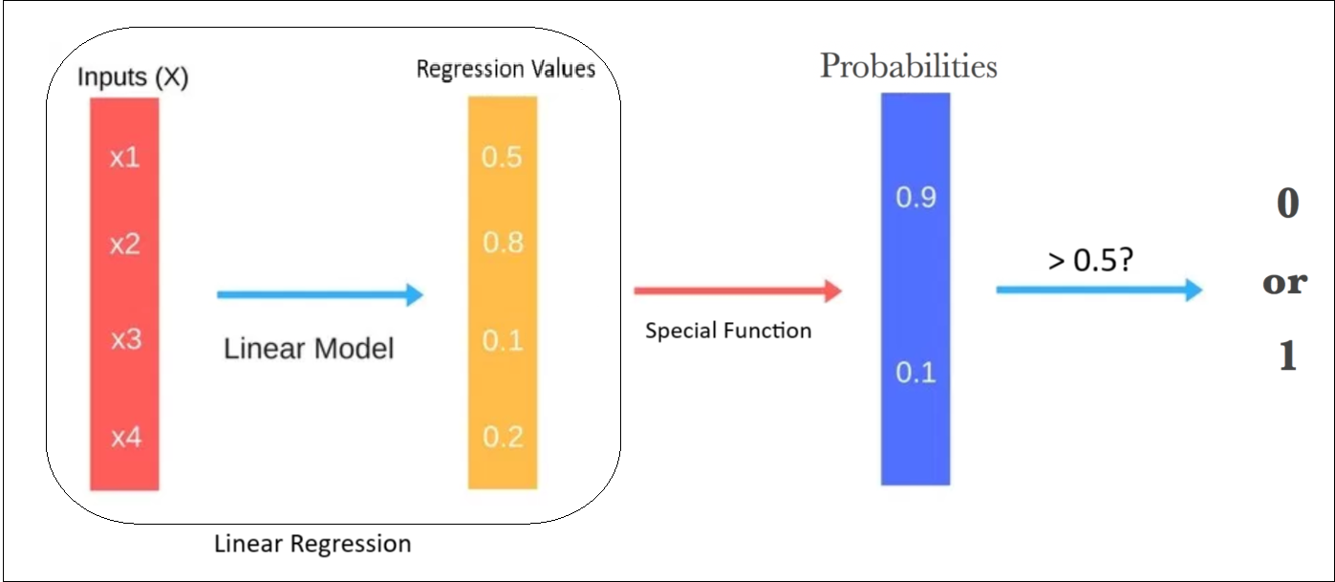
Logistic Regression

Slide 7
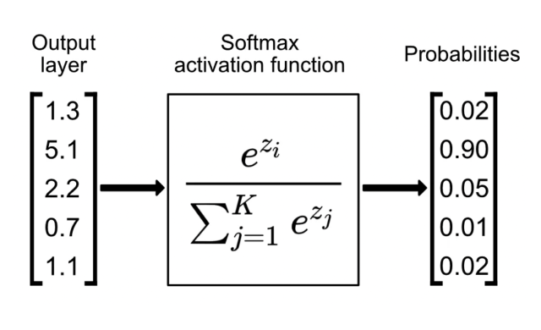

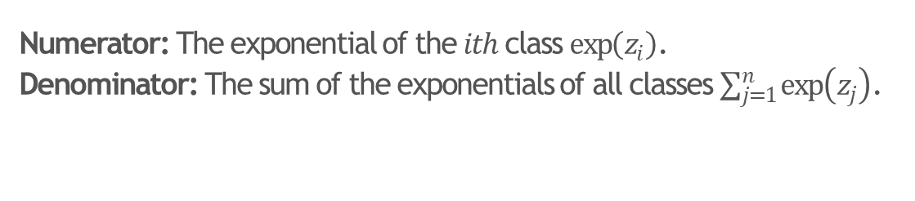
Softmax Function (for Multiclass Classification)
$$Softmax\left(z_{i}\right)=\frac{\exp\left(z_{i}\right)}{\sum_{j=1}^{n}{\exp\left(z_{j}\right)}}$$
Numerator: The exponential of the $ith$ class $\exp\left(z_{i}\right)$.
Denominator: The sum of the exponentials of all classes $\sum_{j=1}^{n}{\exp\left(z_{j}\right)}$.
E.g. Divide the cat value by the cat, dog and deer values to get the cat probability.
Assuming you have K classes, its output would be the probability of the ith class. So, you will run it K times to get the probability of each class.
Note: Sigmoid is a special case of Softmax. Optional: Can you prove it?
Notes:
Z is the output logits (output before converting it to probabilities).
Using softmax instead of direct logits values ratio
Good in representing probabilities
→Fixed range from 0 to 1 (as opposed to -+INF if using linear ratios)
Learning:
→ Non-linear transformation to learn complex patterns
→Always non-zero derivative (as opposed to too small or too large gradients if using linear ratios)
→amplifying the differences with sharp gradient when making errors
\sigma(z) = \frac{1}{1+exp(-z)}
\lim_{z \to \infty} \sigma (z) =0

Slide 8
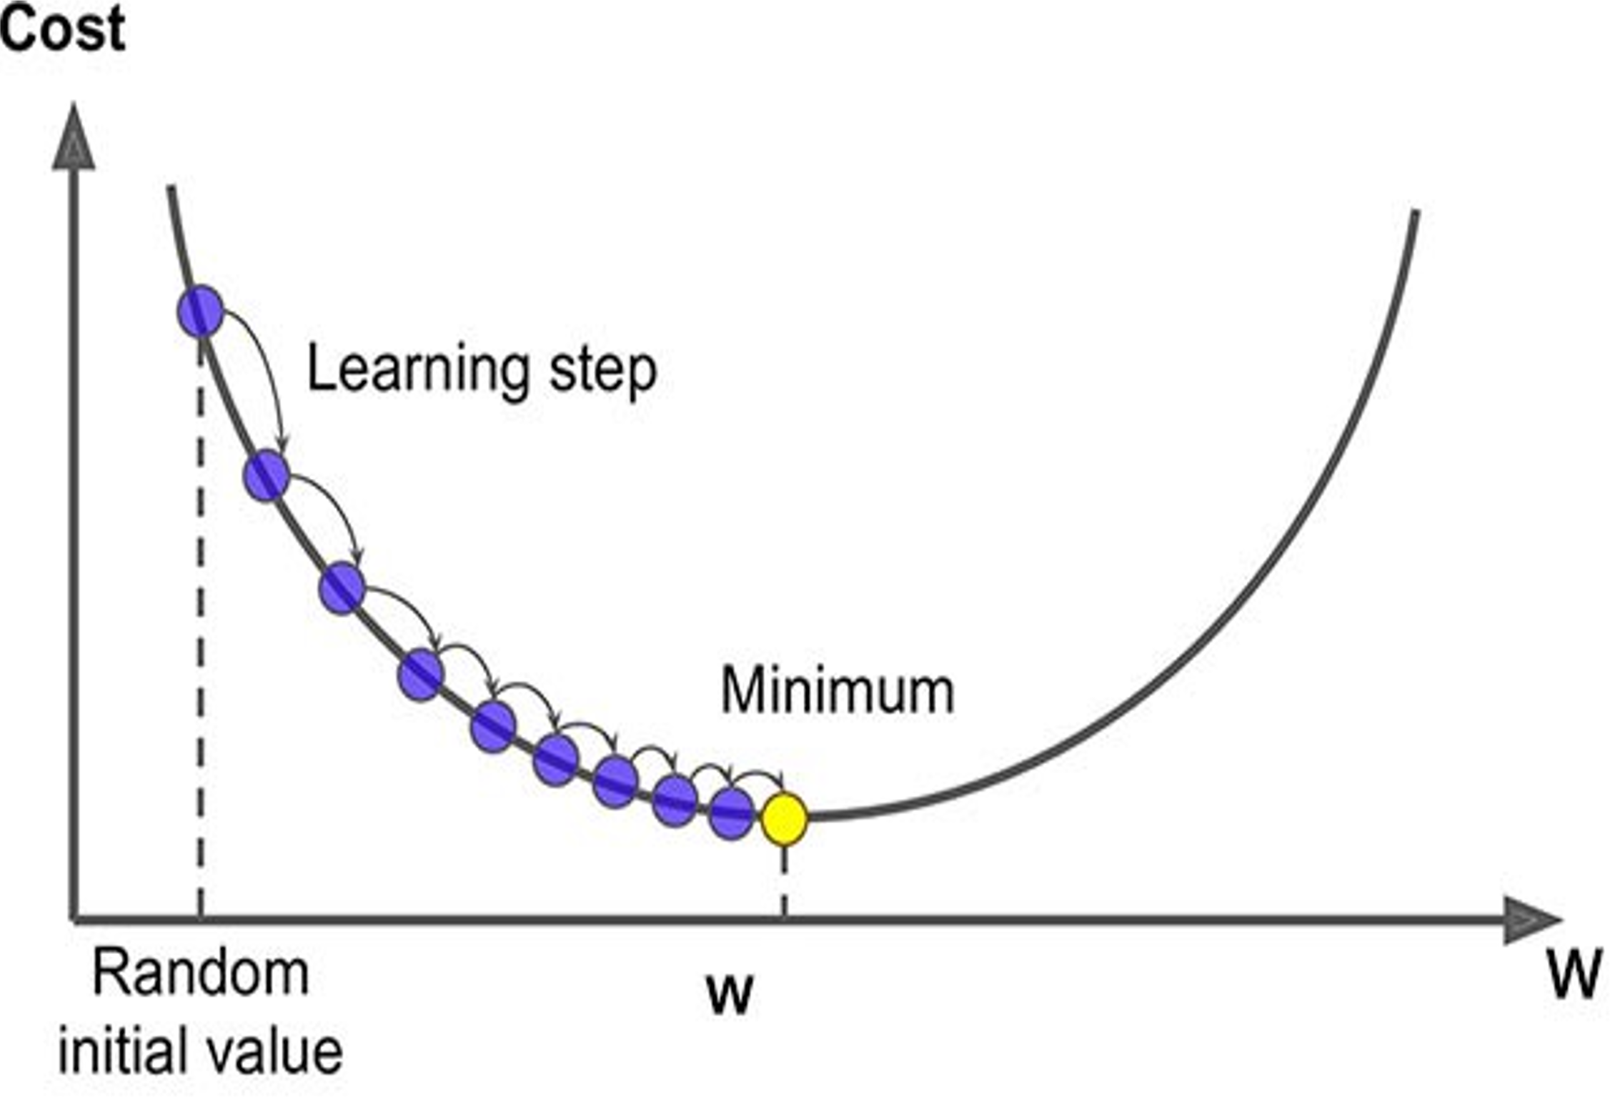
Logistic Regression
Learning rate
We have a linear model for prediction
For classification, we want to output a probability
We map the prediction to probabilities with a sigmoid function
We have a loss function (BCE) to compare models
Notes:
Linear in terms of the dicision boundaries (defined by w^Tx)
But non-linear in terms of the output transformation.
We can calculate the gradient. BUT we can’t find a closed form solution for the weights because of the non-linearity introduced by the sigmoid.
Why? Because the non-linearity applied on the weights stop us from rearranging the formula algebrically to solve for w!

Slide 9
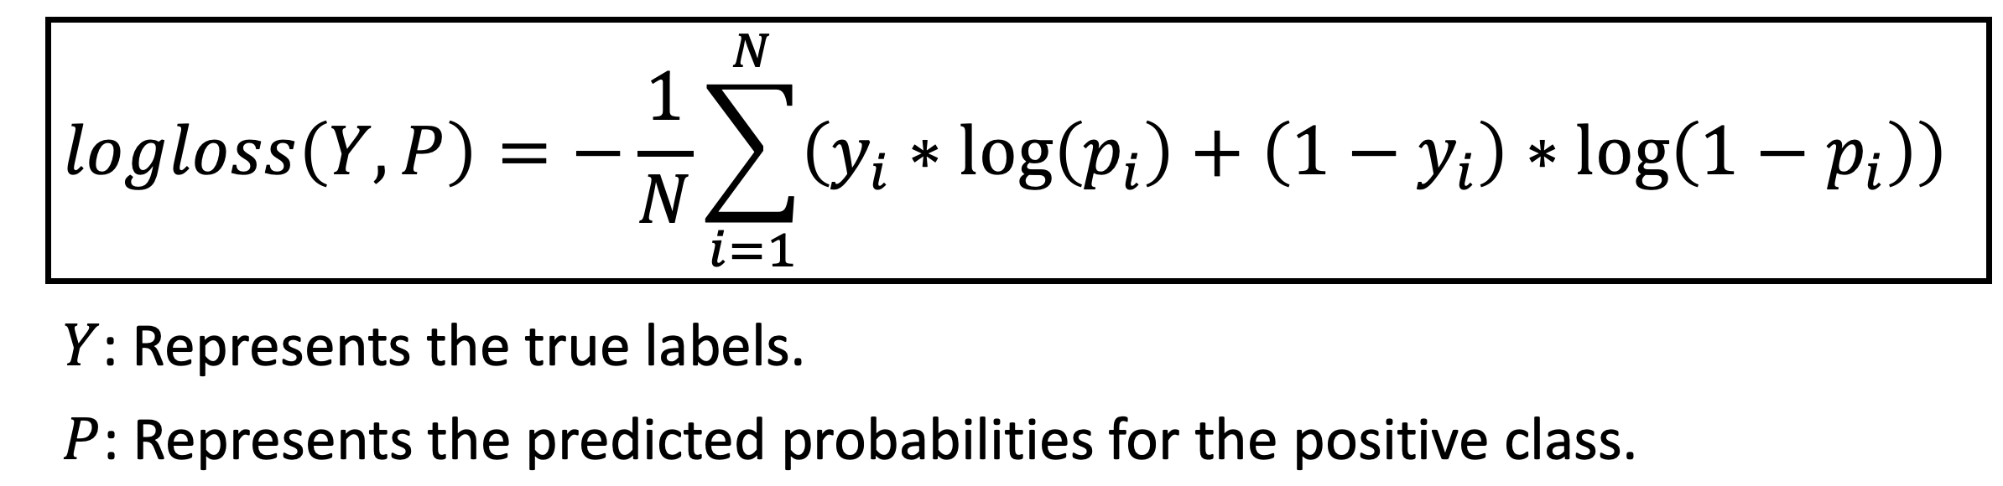
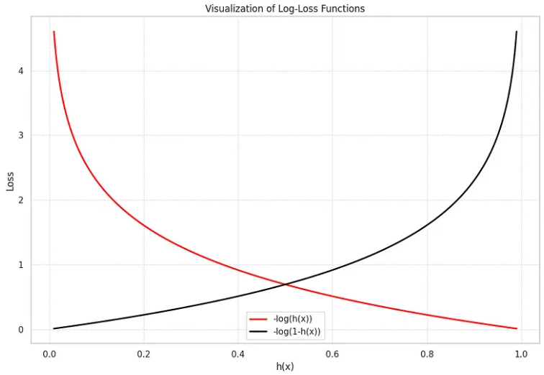

Slide 10

Introduction to Deep Learning
What is a
Neural Network?
deeplearning.ai

Slide 11
Housing Price Prediction
price
size of house

Slide 12
Housing Price Prediction

Slide 13
Housing Price Prediction
size
$$x_{1}$$
#bedrooms
$$x_{2}$$
y
zip code
$$x_{3}$$
wealth
$$x_{4}$$

Slide 14
Introduction to Deep Learning
Supervised Learning
with Neural Networks
deeplearning.ai

Slide 15
Supervised Learning
Input(x)
Output (y)
Application
Home features
Price
Real Estate
Ad, user info
Click on ad? (0/1)
Online Advertising
Image
Object (1,…,1000)
Photo tagging
Audio
Text transcript
Speech recognition
English
Chinese
Machine translation
Image, Radar info
Position of other cars
Autonomous driving

Slide 16
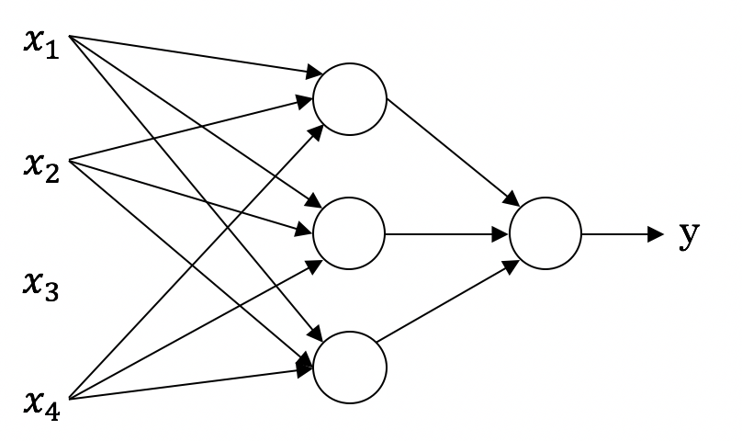
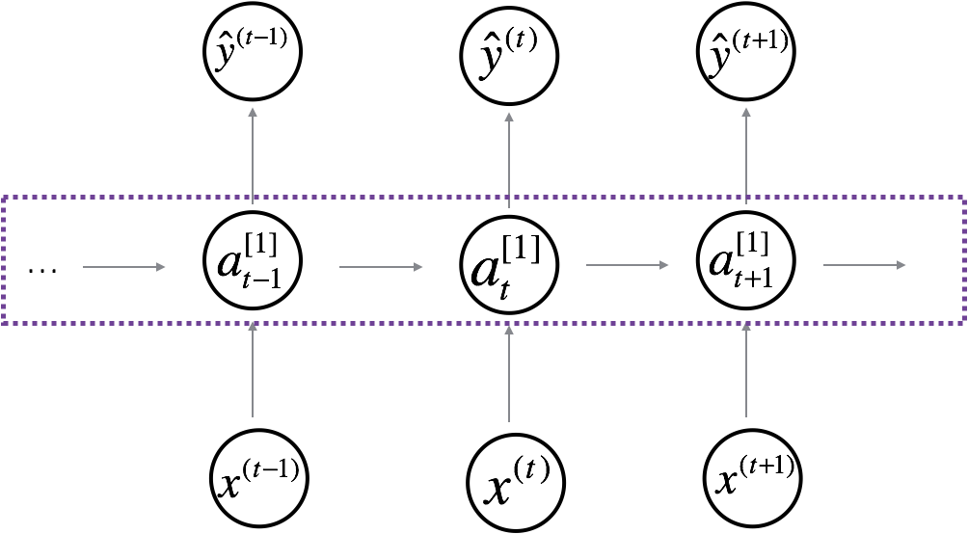
Neural Network examples
Standard NN
Convolutional NN
Recurrent NN

Slide 17
One hidden layer
Neural Network
Neural Networks
Overview

Slide 18
What is a Neural Network?
$$x_{1}$$
$$x_{2}$$
$$\hat{y}$$
$$x_{3}$$
x
w
$$z=w^{T}x+b$$
$$a=σ(z)$$
$$ℒ(a,y)$$
b
$$x_{1}$$
$$x_{2}$$
$$\hat{y}$$
$$x_{3}$$
x
$$W^{[1]}$$
$$z^{[1]}=W^{[1]}x+b^{[1]}$$
$$a^{[1]}=σ(z^{[1]})$$
$$z^{[2]}=W^{[2]}a_{ }^{[1]}+b^{[2]}$$
$$a^{[2]}=σ(z^{[2]})$$
$$ℒ(a^{[2]},y)$$
$$b^{[1]}$$
$$W^{[2]}$$
$$b^{[2]}$$
Notes:
w,x: 3x1 → 1x1
b: 1
W^1: 3x3 (3 features input, 3 neurons)
x: 3x1
w^1X → 3x1
B^1: 3x1
X^2: 3x1
W^2: 1x3
B^2: 1x1
Each hidden layer, is solved similar to logistic regression, but the loss is backprobagated from the output to the input

Slide 19
One hidden layer
Neural Network
Neural Network
Representation

Slide 20
Neural Network Representation
$$x_{1}$$
$$x_{2}$$
$$\hat{y}$$
$$x_{3}$$
Notes:
X_i – input layer of the network
Hidden layer → unseen features
Output layer
2 layer NN

Slide 21
One hidden layer
Neural Network
Computing a
Neural Network’s
Output

Slide 22
Neural Network Representation
$$x_{1}$$
$$x_{1}$$
$$x_{2}$$
$$σ(z)$$
$$a=\hat{y}$$
$$x_{2}$$
$$\hat{y}$$
$$w^{T}x+b$$
$$z$$
$$a$$
$$x_{3}$$
$$x_{3}$$
$$z=w^{T}x+b$$
$$a=σ(z)$$
Notes:
Left side: Similar to logistic regression (single node)

Slide 23
Neural Network Representation
$$x_{1}$$
$$x_{1}$$
$$x_{2}$$
$$σ(z)$$
$$a=\hat{y}$$
$$x_{2}$$
$$\hat{y}$$
$$w^{T}x+b$$
$$z$$
$$a$$
$$x_{3}$$
$$x_{3}$$
$$z=w^{T}x+b$$
$$x_{1}$$
$$a=σ(z)$$
$$x_{2}$$
$$\hat{y}$$
$$x_{3}$$

Slide 24
Neural Network Representation
$$a_{1}^{\left[1\right]}$$
$z_{1}^{\left[1\right]}=w_{1}^{{\left[1\right]T}^{ }}x+b_{1}^{[1]}, a_{ 1}^{[1]}=σ(z_{1}^{\left[1\right]}$)
$$x_{1}$$
$$a_{2}^{\left[1\right]}$$
$z_{2}^{\left[1\right]}=w_{2}^{{\left[1\right]T}^{ }}x+b_{2}^{[1]}, a_{ 2}^{[1]}=σ(z_{2}^{\left[1\right]}$)
$$x_{2}$$
$$\hat{y}$$
$$a_{3}^{\left[1\right]}$$
$z_{3}^{\left[1\right]}=w_{3}^{{\left[1\right]T}^{ }}x+b_{3}^{[1]}, a_{ 3}^{[1]}=σ(z_{3}^{\left[1\right]}$)
$$x_{3}$$
$$a_{4}^{\left[1\right]}$$
$z_{4}^{\left[1\right]}=w_{4}^{{\left[1\right]T}^{ }}x+b_{4}^{[1]}, a_{ 4}^{[1]}=σ(z_{4}^{\left[1\right]}$)
Notes:
Sigmoid → limit the response you get in each output
So are we going to loop over an calculated each seperatly? NO → Vectorised representation

Slide 25
Neural Network Representation learning
$$a_{1}^{\left[1\right]}$$
Given input x:
$$x_{1}$$
$$a_{2}^{\left[1\right]}$$
$$z^{\left[1\right]}=W^{\left[1\right]}x+b^{\left[1\right]}$$
$$x_{2}$$
$$\hat{y}$$
$$a_{3}^{\left[1\right]}$$
$$x_{3}$$
$$a^{\left[1\right]}=σ(z^{\left[1\right]})$$
$$a_{4}^{\left[1\right]}$$
$$z^{\left[2\right]}=W^{\left[2\right]}a^{\left[1\right]}+b^{\left[2\right]}$$
$$a^{\left[2\right]}=σ(z^{\left[2\right]})$$
Notes:
Stacking Ws together → 4x3 matrix → Each row representing the weights of different node
X: 3x1
b: 4x1
At the output: w:1x4 and b:1x1 → logistic regression
Element-wise sigmoid, can run in parallel to make it faster (independence of nodes)

Slide 26
One hidden layer
Neural Network
Vectorizing across
multiple examples

Slide 27
Vectorizing across multiple examples
$$z^{\left[1\right]}=W^{\left[1\right]}x+b^{\left[1\right]}$$
$$x_{1}$$
$$a^{\left[1\right]}=σ(z^{\left[1\right]})$$
$$x_{2}$$
$$\hat{y}$$
$$z^{\left[2\right]}=W^{\left[2\right]}a^{\left[1\right]}+b^{\left[2\right]}$$
$$x_{3}$$
$$a^{\left[2\right]}=σ(z^{\left[2\right]})$$

Slide 28
Vectorizing across multiple examples
for i = 1 to m:
$$z^{\left[1\right](i)}=W^{\left[1\right]}x^{(i)}+b^{\left[1\right]}$$
$$a^{\left[1\right](i)}=σ(z^{\left[1\right]\left(i\right)})$$
$$z^{\left[2\right](i)}=W^{\left[2\right]}a^{\left[1\right](i)}+b^{\left[2\right]}$$
$$a^{\left[2\right](i)}=σ(z^{\left[2\right]\left(i\right)})$$
$$Z^{\left[1\right]}=W^{\left[1\right]}X+b^{\left[1\right]}$$
$$A^{\left[1\right]}=σ(Z^{\left[1\right]})$$
$$Z^{\left[2\right]}=W^{\left[2\right]}A^{\left[1\right]}+b^{\left[2\right]}$$
$$A^{\left[2\right]}=σ(Z^{\left[2\right]})$$
Notes:
Unvectorised
W^[1]: 4xd
X: dxm (samples as columns)
B: 4x1 (note that we will add this to a 4xm by copying it m times)
Output: 4xm
Next layer:
a^[1]: 4xm
W^[2]: 1x4
b^[2]: 1x1
Output: 1x1

Slide 29
One hidden layer
Neural Network
Explanation
for vectorized
implementation

Slide 30
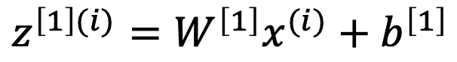
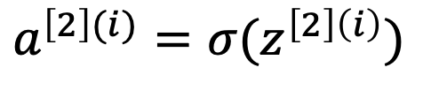
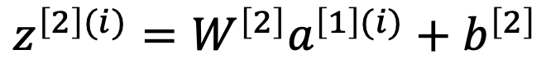
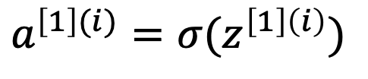
Justification for vectorized implementation
for i = 1 to m:
$$z^{\left[1\right](i)}=W^{\left[1\right]}x^{(i)}+b^{\left[1\right]}$$
$$a^{\left[1\right](i)}=σ(z^{\left[1\right]\left(i\right)})$$
$$z^{\left[2\right](i)}=W^{\left[2\right]}a^{\left[1\right](i)}+b^{\left[2\right]}$$
$$a^{\left[2\right](i)}=σ(z^{\left[2\right]\left(i\right)})$$
$$Z^{\left[1\right]}=W^{\left[1\right]}X+b^{\left[1\right]}$$
$$A^{\left[1\right]}=σ(Z^{\left[1\right]})$$
$$Z^{\left[2\right]}=W^{\left[2\right]}A^{\left[1\right]}+b^{\left[2\right]}$$
$$A^{\left[2\right]}=σ(Z^{\left[2\right]})$$
Notes:
Ignore the bias and sigmoid for simplicity
Single example:
z^[1](1) = w^[1]x^(1) (b canceled for simplicity)
w^[1]: 4xd (4 neurons)
x^(1): dx1 (1 example)
Output: 4x1
Multiple data samples:
X: dxm
W^[1] is exactly the same
Output: 4xm
m can be you batch size (remember SGD)

Slide 31
Recap of vectorizing across multiple examples
for i = 1 to m
$$x_{1}$$
$$z^{\left[1\right](i)}=W^{\left[1\right]}x^{(i)}+b^{\left[1\right]}$$
$$x_{2}$$
$$\hat{y}$$
$$x_{3}$$
$$a^{\left[1\right](i)}=σ(z^{\left[1\right]\left(i\right)})$$
$$z^{\left[2\right](i)}=W^{\left[2\right]}a^{\left[1\right](i)}+b^{\left[2\right]}$$
$$a^{\left[2\right](i)}=σ(z^{\left[2\right]\left(i\right)})$$
$$X=$$
$$x^{(1)}$$
$$x^{(2)}$$
…
$$x^{(m)}$$
$$Z^{\left[1\right]}=W^{\left[1\right]}X+b^{\left[1\right]}$$
$$A^{\left[1\right]}=σ(Z^{\left[1\right]})$$
$$Z^{\left[2\right]}=W^{\left[2\right]}A^{\left[1\right]}+b^{\left[2\right]}$$
$A^{[1]}=$
$$a^{[1](1)}$$
$$a^{[1](2)}$$
$$a^{[1](m)}$$
…
$$A^{\left[2\right]}=σ(Z^{\left[2\right]})$$

Slide 32
One hidden layer
Neural Network
Activation functions

Slide 33
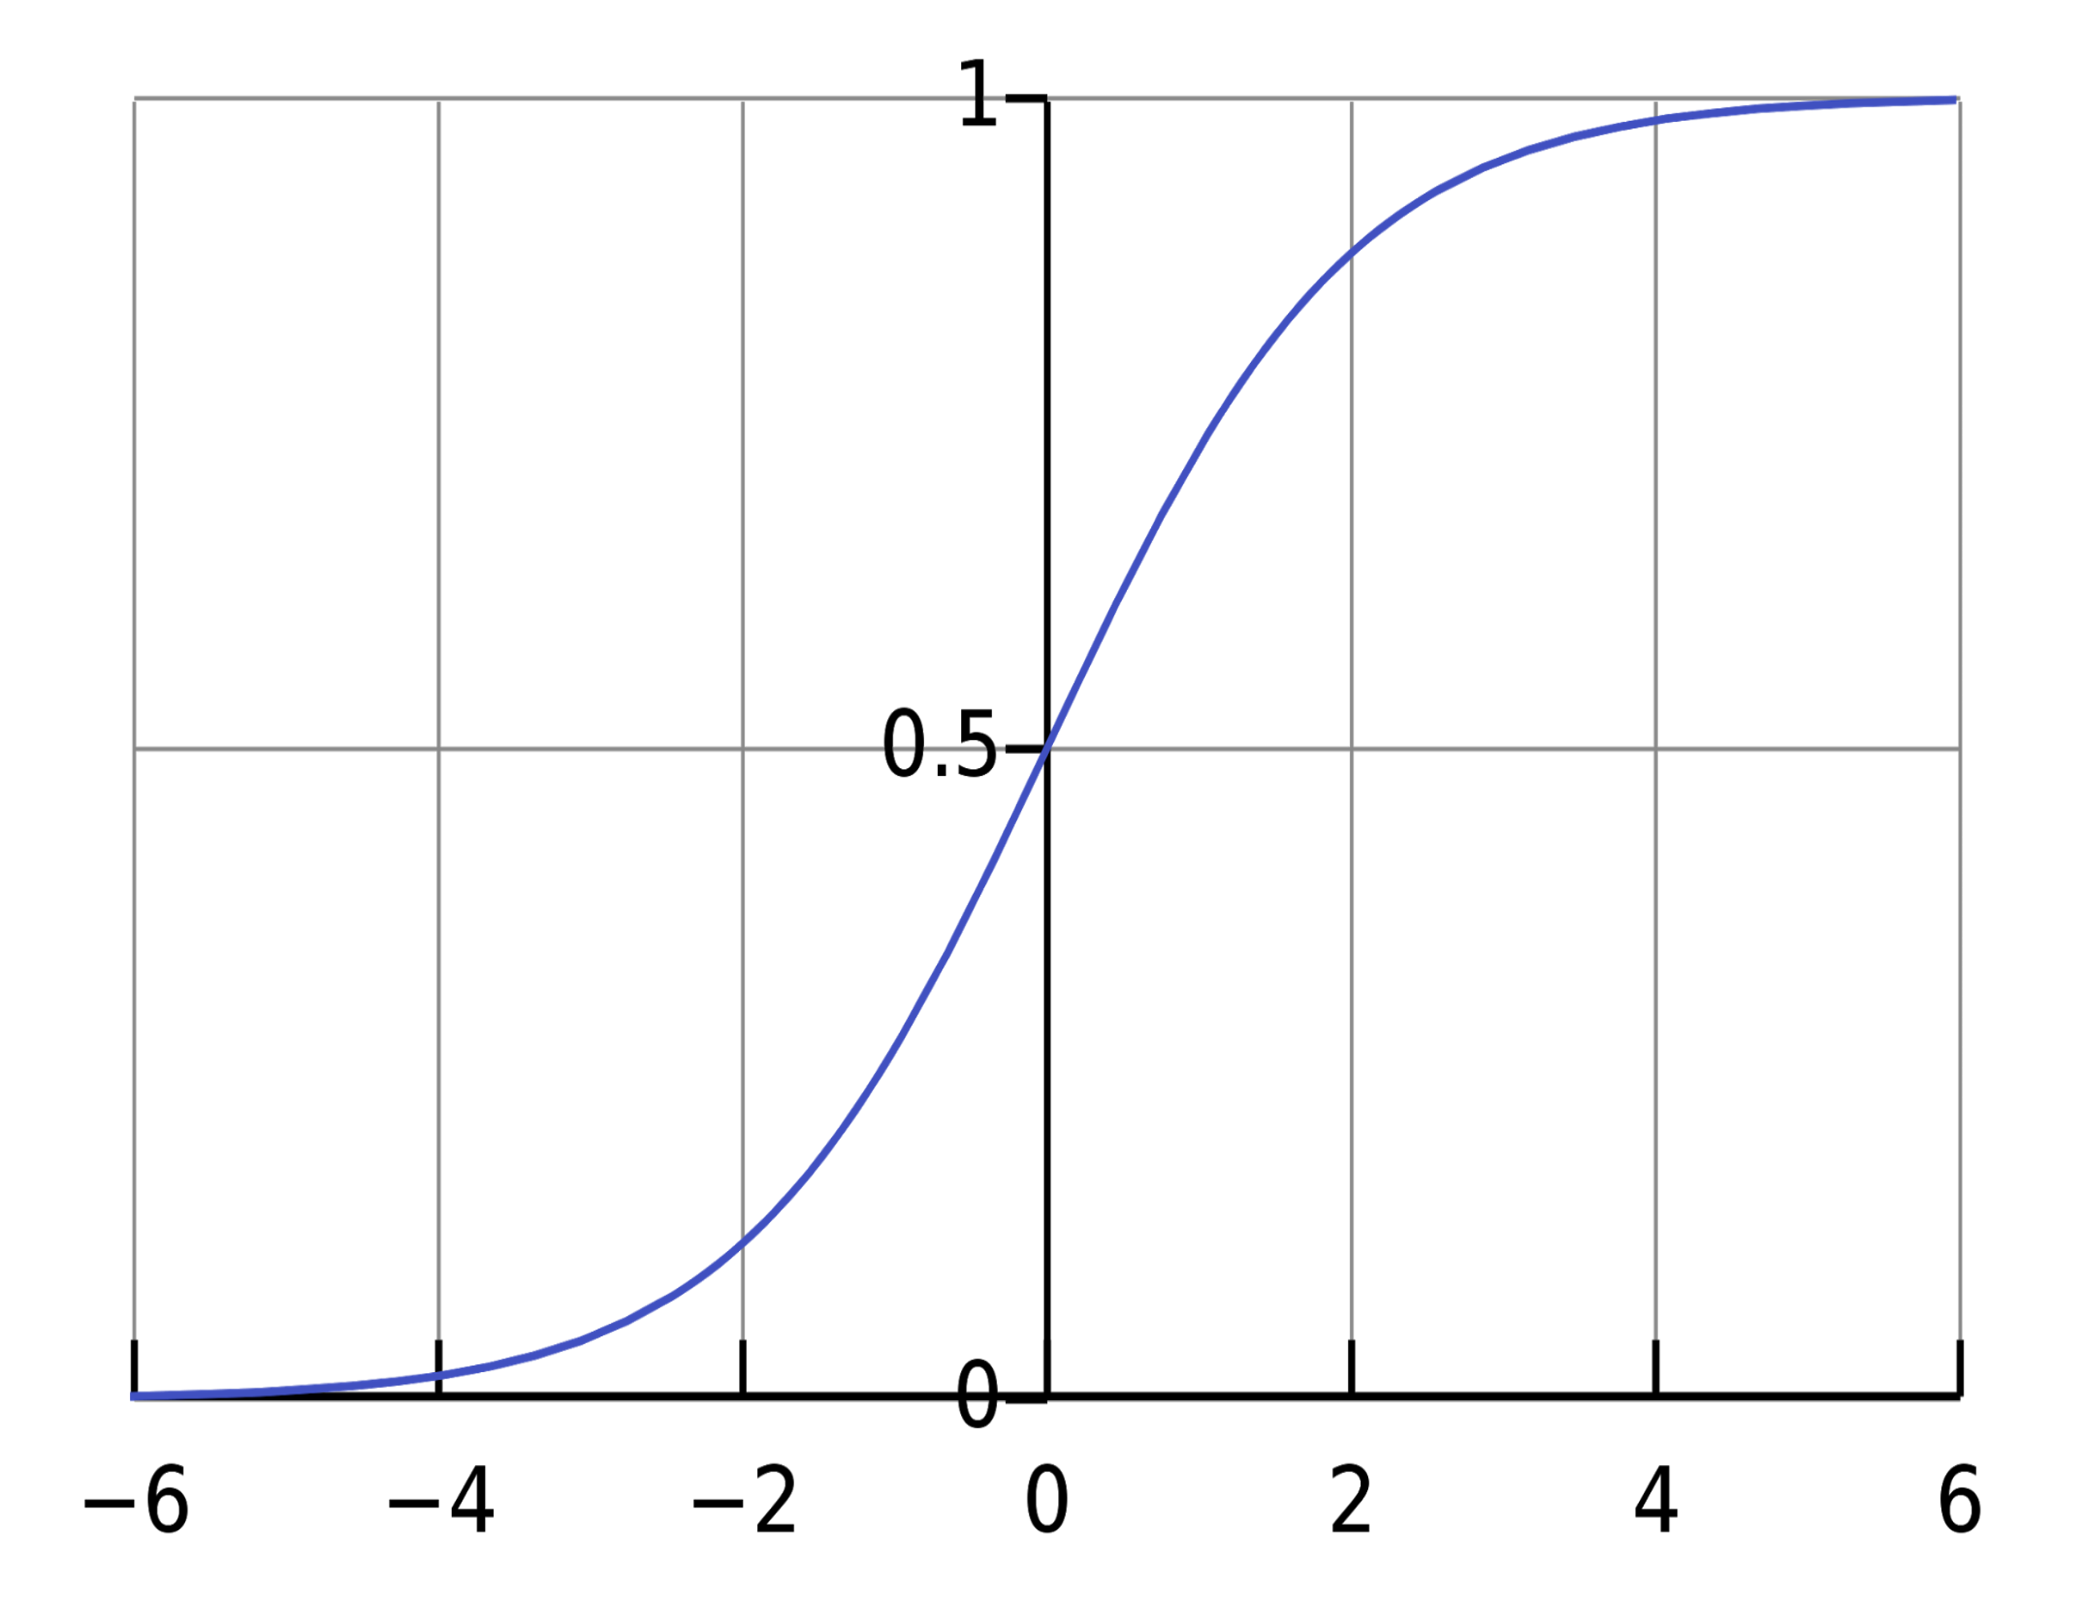
Activation functions
$$x_{1}$$
$$x_{2}$$
$$\hat{y}$$
$$x_{3}$$
z
Given x:
$$z^{\left[1\right]}=W^{\left[1\right]}x+b^{\left[1\right]}$$
$$a^{\left[1\right]}=σ(z^{\left[1\right]})$$
$$z^{\left[2\right]}=W^{\left[2\right]}a^{\left[1\right]}+b^{\left[2\right]}$$
$$a^{\left[2\right]}=σ(z^{\left[2\right]})$$

Slide 34
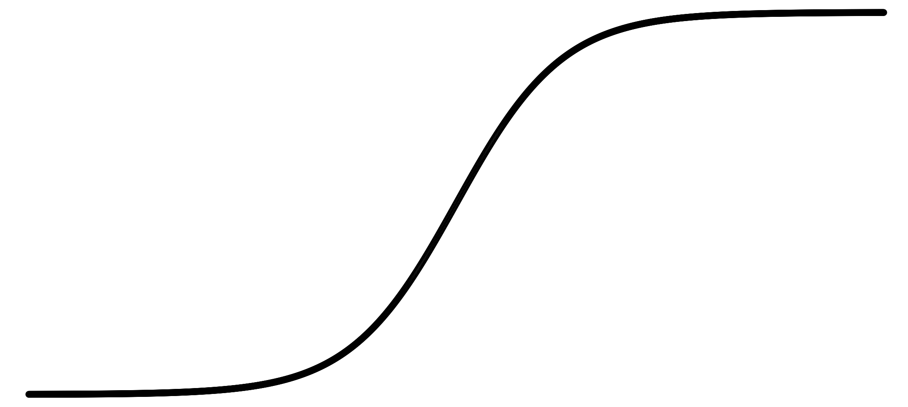
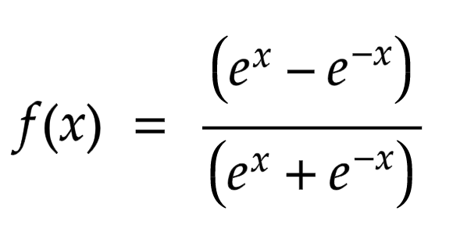
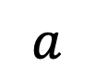
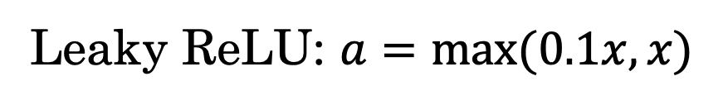
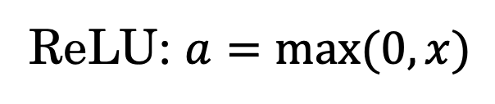
Pros and cons of activation functions
a
a
x
z
$$a= \frac{1}{1+e^{−z}}$$
sigmoid:
tanh:
$$a$$
a
a
Not differentiable ➔ subgradient!
If z = 0 ➔ grad = 0
z
z
ReLU: $a=max⁡(0, x)$
Leaky ReLU: $a=max⁡(0.1x, x)$
Notes:
Tanh nice features: +-1 range, with zero mean, but we still need sigmoid for the output
Problem of sigmoid and tanh: vanishing gradient, reaching a zero gradient for high and low z values
ReLU help in avoiding that
Problem:dying ReLU problem! RelU blocking values less than zero, so the same problem again, getting stuck at zero gradient reigons.
Leaky ReLU solve that issue
At the output, we still use softmax (sigmoid)
Note: z = wx+b

Slide 35
One hidden layer
Neural Network
Why do you
need non-linear
activation functions?

Slide 36
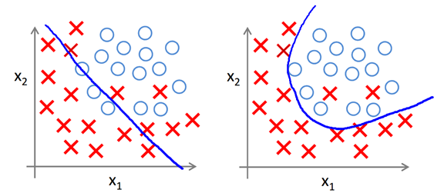

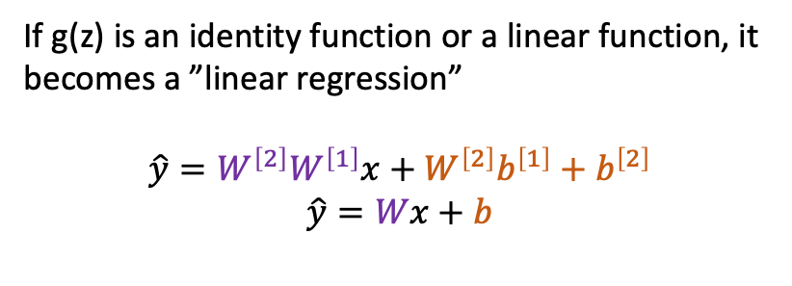
Activation function
If g(z) is an identity function or a linear function, it becomes a ”linear regression”
$$\hat{y}=W^{\left[2\right]}W^{\left[1\right]}x+W^{\left[2\right]}b^{\left[1\right]}+b^{\left[2\right]}$$
$$\hat{y}=Wx+b$$
$$x_{1}$$
$$x_{2}$$
$$\hat{y}$$
$$x_{3}$$
Given x:
$$z^{\left[1\right]}=W^{\left[1\right]}x+b^{\left[1\right]}$$
For classification $g^{[2]}$ is sigmoid, how do we do regression?
$$a^{\left[1\right]}=g^{[1]}(z^{\left[1\right]})$$
a
$$z^{\left[2\right]}=W^{\left[2\right]}a^{\left[1\right]}+b^{\left[2\right]}$$
$$a^{\left[2\right]}=g^{[2]}(z^{\left[2\right]})$$
z
Notes:
If you don’t use a non-linear function, y^ = Wx+b, where
W = W[2]W[1]x + (w[2]b[1] + wb[1])
➔ = Wx + b
No different than linear regression ➔ deep NNs not useful
But we need more complex curves not a line!
How to do regression?

Slide 37
One hidden layer
Neural Network
Gradient descent for
neural networks

Slide 38
Gradient descent for neural networks

Slide 39
Formulas for computing derivatives

Slide 40
One hidden layer
Neural Network
Backpropagation
intuition

Slide 41
Computing gradients
Logistic regression
$$x$$
$$w$$
$$z=w^{T}x+b$$
$$a= σ(z)$$
$$ℒ(a,y)$$
$$b$$

Slide 42
Neural network gradients
$$W^{[2]}$$
$$x$$
$$b^{[2]}$$
$$W^{[1]}$$
$$z^{[1]}=W^{[1]}x+b^{[1]}$$
$$a^{[1]}= σ(z^{[1]})$$
$$z^{[2]}=W^{[2]}x+b^{[2]}$$
$$a^{[2]}= σ(z^{[2]})$$
$$ℒ(a^{[2]},y)$$
$$b^{[1]}$$

Slide 43
Summary of gradient descent
$$dz^{[2]}=a^{[2]}−y$$
$$dW^{[2]}=dz^{[2]}a^{{\left[1\right]}^{T}}$$
$$db^{[2]}=dz^{[2]}$$
$$dz^{[1]}=W^{\left[2\right]T}dz^{[2]}∗g^{[1]}′(z^{\left[1\right]})$$
$$dW^{[1]}=dz^{[1]}x^{T}$$
$$db^{[1]}=dz^{[1]}$$

Slide 44
Summary of gradient descent
$$dz^{[2]}=a^{[2]}−y$$
$$dZ^{[2]}=A^{[2]}−Y$$
$$dW^{[2]}=dz^{[2]}a^{{\left[1\right]}^{T}}$$
$$dW^{[2]}=\frac{1}{m}dZ^{[2]}A^{{\left[1\right]}^{T}}$$
$$db^{[2]}=dz^{[2]}$$
$$db^{[2]}=\frac{1}{m}np.sum(dZ^{\left[2\right]},axis=1, keepdims=True)$$
$$dz^{[1]}=W^{\left[2\right]T}dz^{[2]}∗g^{[1]}′(z^{\left[1\right]})$$
$$dZ^{[1]}=W^{\left[2\right]T}dZ^{[2]}∗g^{[1]}′(Z^{\left[1\right]})$$
$$dW^{[1]}=dz^{[1]}x^{T}$$
$$dW^{[1]}=\frac{1}{m}dZ^{[1]}X^{T}$$
$$db^{[1]}=dz^{[1]}$$
$$db^{[1]}=\frac{1}{m}np.sum(dZ^{\left[1\right]},axis=1, keepdims=True)$$
Notes:
In the vectorized:
dZ[1]: n[1] x m,
w[2]TfZ[2]: n[1] x m
Note W[2] is n[1] x n[2] and dz[2] is n[2] x m
And the later term is n[1] x m

Slide 45
Introduction to Neural Networks
Why is Deep Learning taking off?
deeplearning.ai

Slide 46
Scale drives deep learning progress
Performance
Amount of data

Slide 47

Scale drives deep learning progress
Idea
Data
Computation
Algorithms
Experiment
Code

Slide 48
One hidden layer
Neural Network
Random Initialization

Slide 49
What happens if you initialize weights to zero?
$$x_{1}$$
$$a_{1}^{[1]}$$
$$a_{1}^{[2]}$$
$$\hat{y}$$
$$x_{2}$$
$$a_{2}^{[1]}$$

Slide 50
Random initialization
$$x_{1}$$
$$a_{1}^{[1]}$$
$$a_{1}^{[2]}$$
$$\hat{y}$$
$$x_{2}$$
$$a_{2}^{[1]}$$

Slide 51
Deep Neural Networks
Getting your matrix
dimensions right

Slide 52
Parameters $W^{[l]}$ and $b^{[l]}$
$$x_{1}$$
$$\hat{y}$$
$$x_{2}$$

Slide 53
Vectorized implementation
$$x_{1}$$
$$\hat{y}$$
$$x_{2}$$

Slide 54
Deep Neural Networks
Why deep
representations?

Slide 55

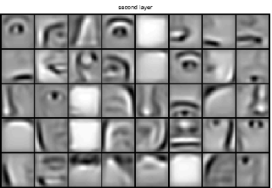
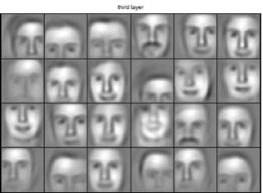
Intuition about deep representation
$$\hat{y}$$

Slide 56
Circuit theory and deep learning
Informally: There are functions you can compute with a “small” L-layer deep neural network that shallower networks require exponentially more hidden units to compute.

Slide 57
Deep Neural Networks
Building blocks of
deep neural networks

Slide 58
Forward and backward functions
$$x_{1}$$
$$x_{2}$$
$$\hat{y}$$
$$x_{3}$$
$$x_{4}$$

Slide 59
Forward and backward functions

Slide 60
Deep Neural Networks
Forward and backward
propagation

Slide 61
Forward propagation for layer l
Input $a^{[l−1]}$
O$utput a^{[l]},$cache ($z^{[l]}$)

Slide 62
Backward propagation for layer l
Input ${da}^{[l]}$
O$utput {da}^{\left[l−1\right]},dW^{\left[l\right]},db^{[l]}$

Slide 63
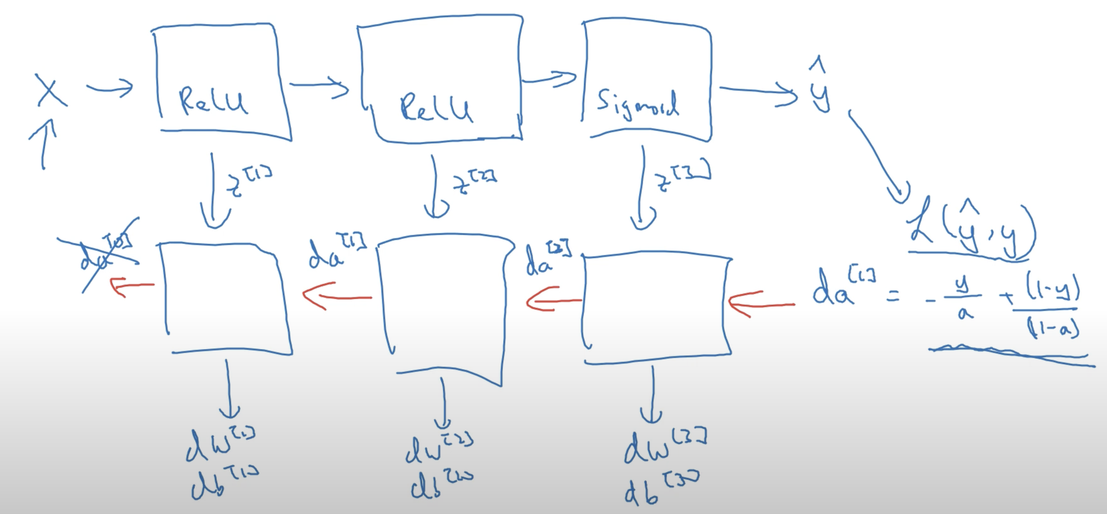
Summary

